Slide 1
Are you ready for online learning?
20 questions to measure your readiness to study online at YTC College

Slide 2
Thinking of online study?
If you can answer “Yes” to most or all of the following questions, taking University courses online may be a good choice for you.

Slide 3
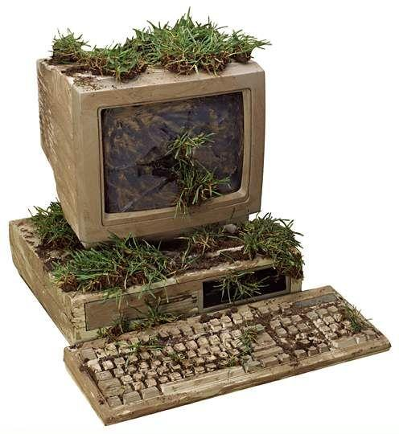
Is your computer three years old or less, free from virus problems, and running reliably on Windows 7, Windows Vista, Windows XP or higher?

Slide 4
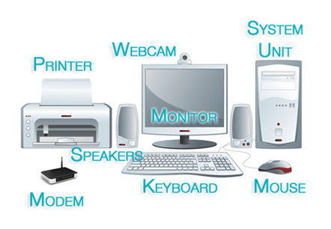
Do you own the computer that you will use for class, and does it include a printer, headphones or speakers, and a microphone?

Slide 5
Do you have a hard wired connection to the Internet using either a high speed DSL or cable connection?

Slide 6
Is your browser able to play common video and audio formats?

Slide 7
Is your computer equipped with desktop software such as Microsoft Word or PowerPoint and are you familiar with their basic use?

Slide 8
Do you have reliable and current virus protection software on your computer?

Slide 9
Are you comfortable with installing or downloading software and adding a printer or other devices when needed?

Slide 10
Can you identify and correct simple computer problems, or do you have access to someone who can help ?

Slide 11
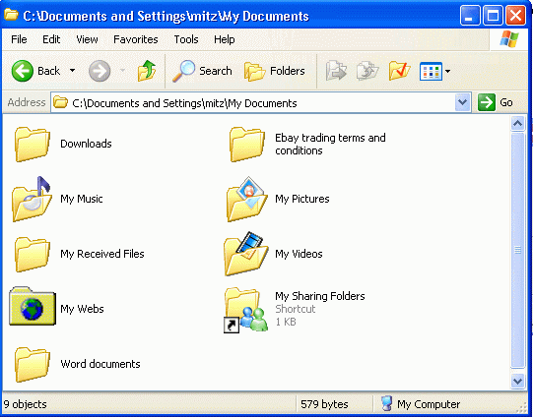
Can you perform basic computer tasks such as saving files, creating folders, and moving files?

Slide 12
Do you have basic Internet skills such as doing searches, setting bookmarks, and downloading files or plug-ins, and are you experienced in using email?

Slide 13
Would you be able to remain motivated working on your own?

Slide 14
Do you usually persist through difficulties and finish things you start?

Slide 15
Is it highly important to you to finish your degree program?

Slide 16
Are you willing to spend 7-10 or more hours each week on your online course?

Slide 17
Do you plan work in advance to stay on a schedule?

Slide 18
Do you have a dedicated space where you can study without being interrupted?

Slide 19
Are you able and willing to set aside uninterrupted time to study?

Slide 20
Can you learn from material presented in video clips, audio recordings, podcasts, or online text?

Slide 21
Do you have good enough reading comprehension to be comfortable with reading to learn the majority of the course content?

Slide 22
Are you comfortable with communicating through online chat, posted discussions, email, or blogs?

Slide 23
If you answered “Yes” to most or all of these questions, contact your YTC Student Advisor soon to check out learning opportunities online at YTC College!

